Slide 1
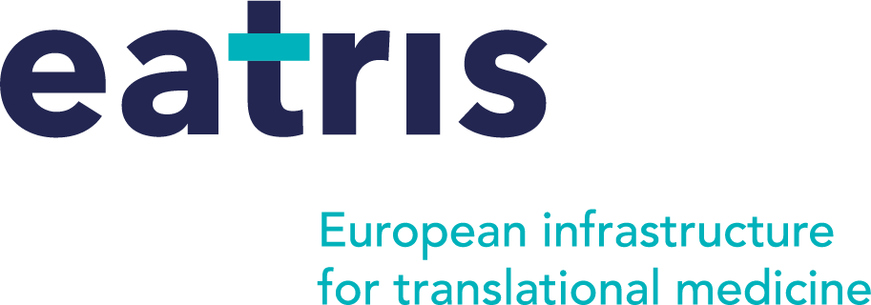
Multi-disciplinary collaboration as enablers of digitalisation and AI
Anton Ussi Operations & Finance Director
antonussi@eatris.eu
Dr Sara Zullino Scientific Programme Manager
sarazullino@eatris.eu
Research Infrastructures in a Changing Global, Environmental and Socio-economical Context, Brussels 4-5 June 2024

Slide 2
From technology push to market pull
Translational research is
multi-disciplinary, multi-sectoral, patient-centred
Industry
Our mission
To accelerate the translation of scientific discoveries into benefit for patients and society
Regulators
Academia
Clinicians
Patients

Slide 3
Translational research paradigm
Understanding mechanisms
EATRIS core activities
1
User access - experts and facilities
Technology
Platforms
2
Develop new research tools
3
Provide education and training
Biological insights
Clinical observations
4
Develop better cross-sectoral collaborations

Slide 4
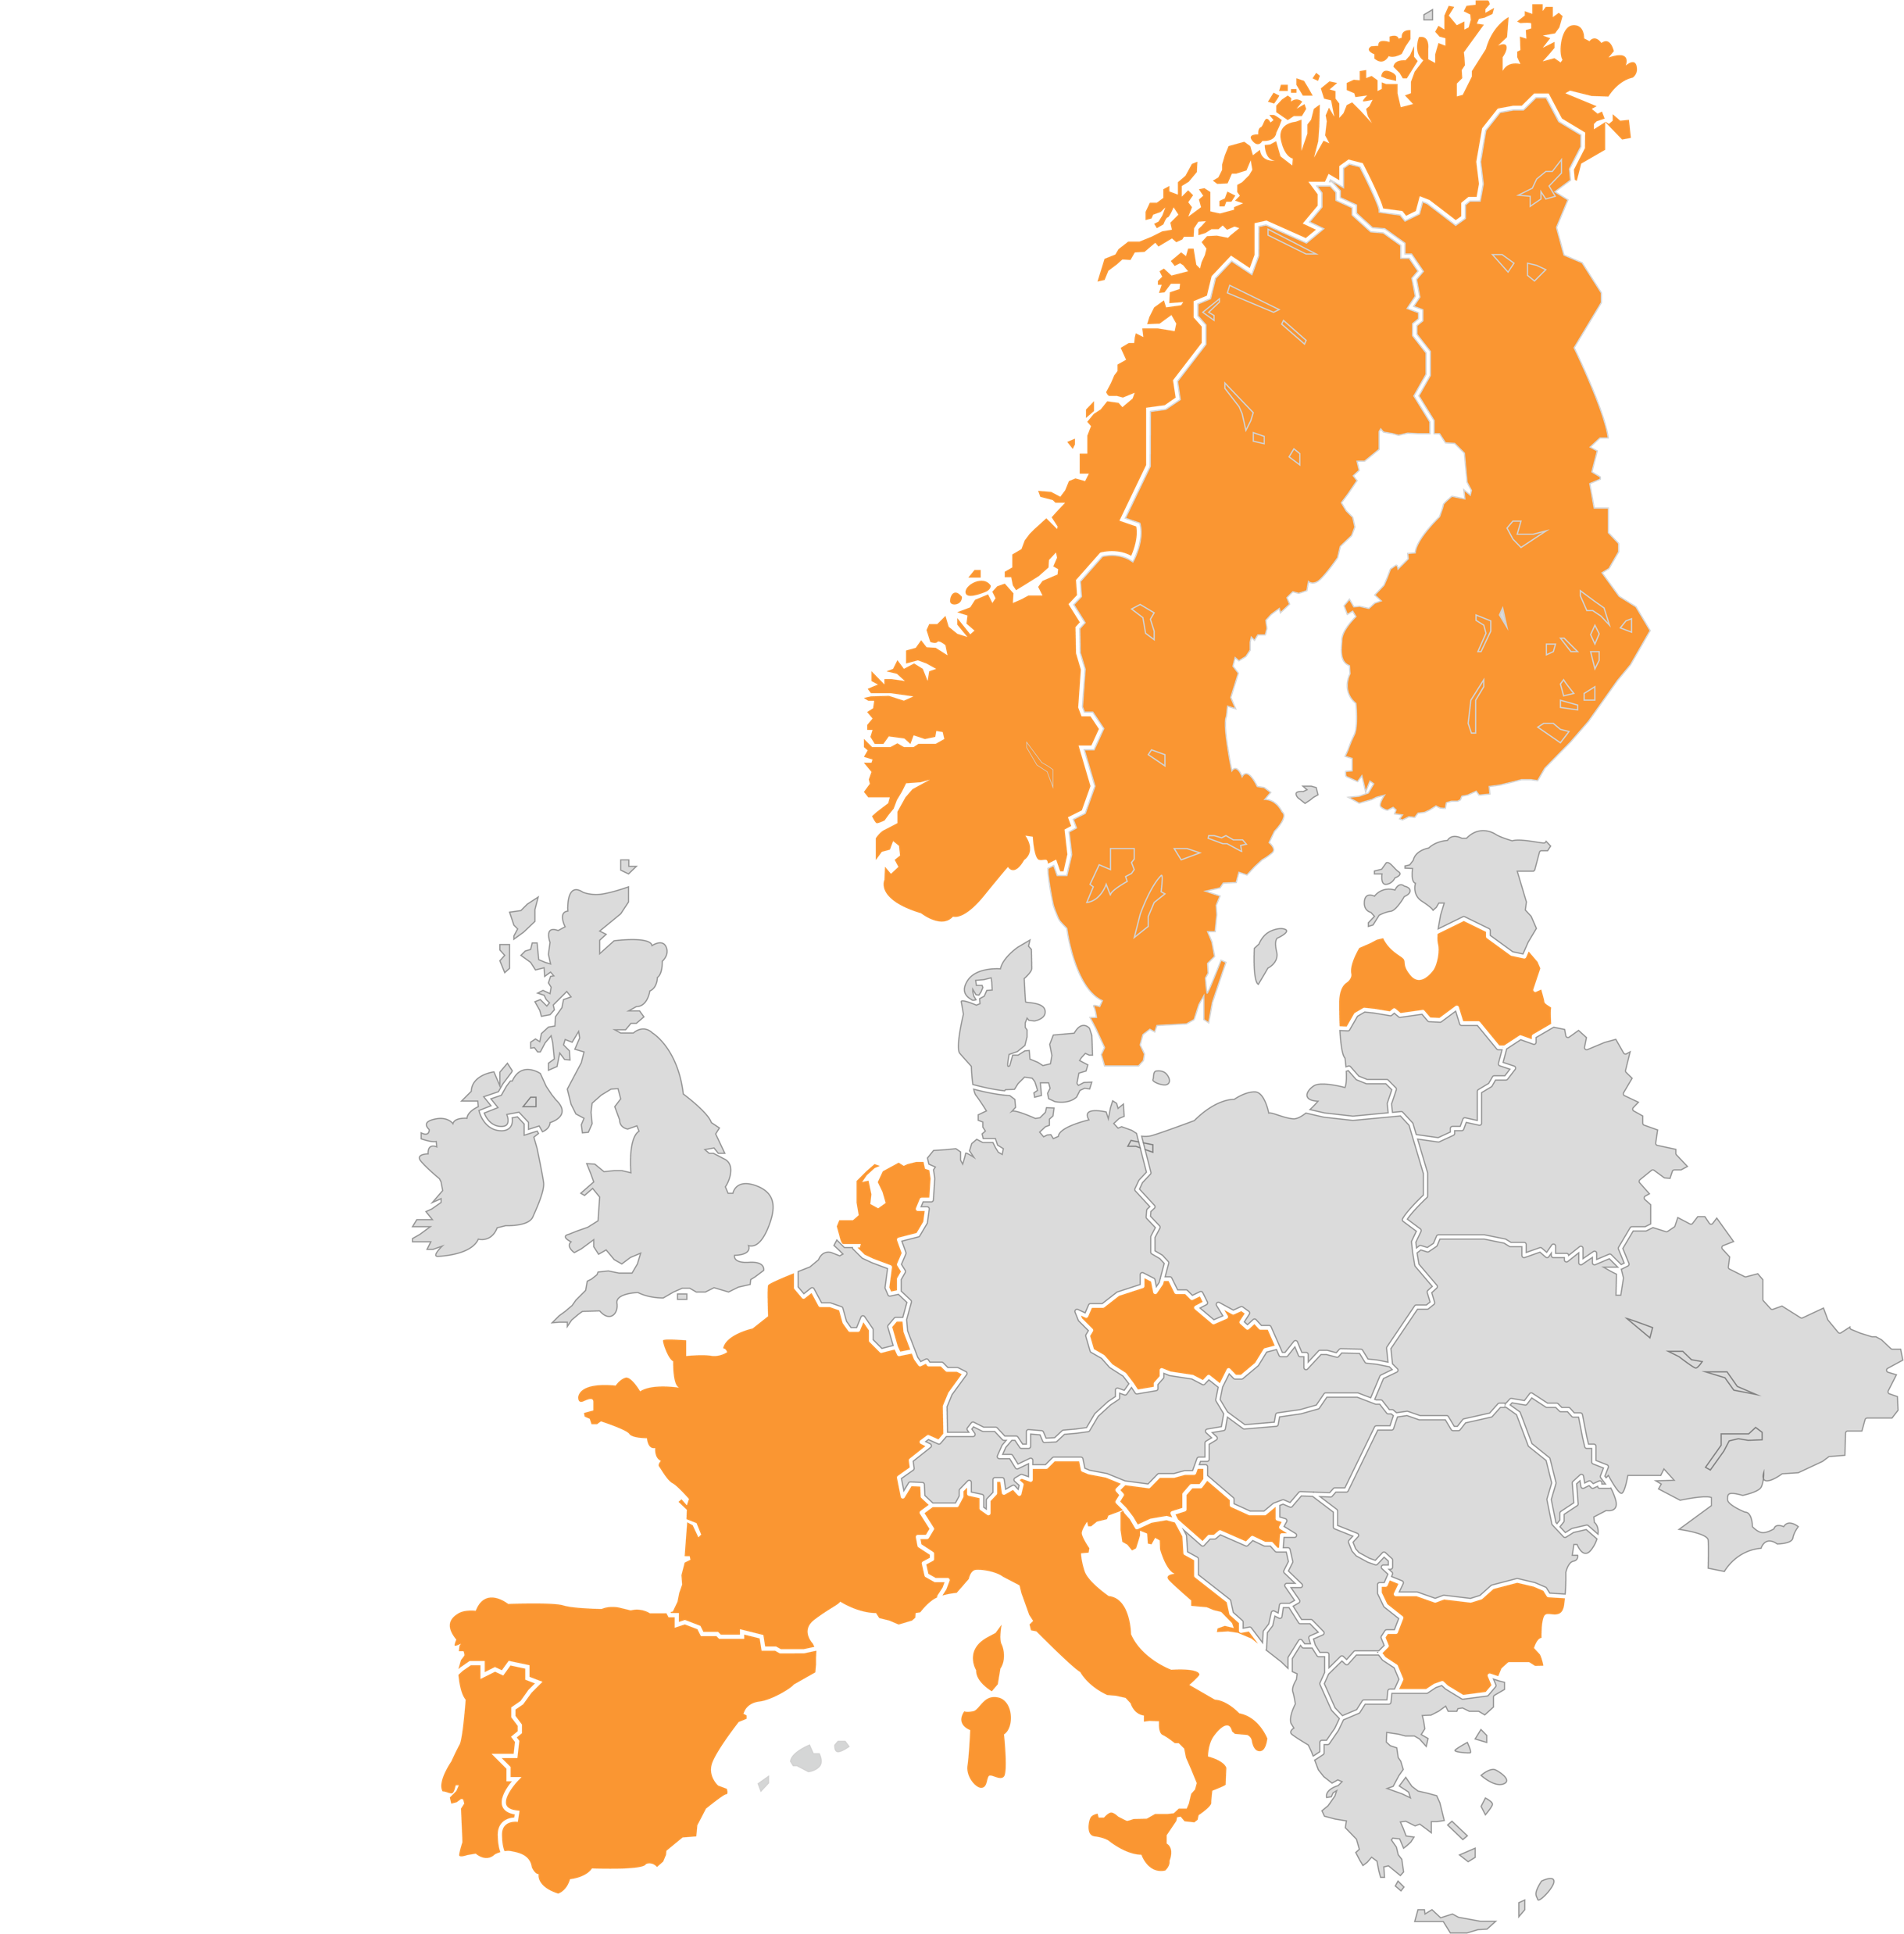
Who we are
Facilities, resources and services to support cutting edge applied research
Members
Bulgaria, Croatia, Czech Republic, Finland, France, Italy, Latvia, Luxembourg, Netherlands, Norway, Portugal, Slovenia, Spain, Sweden
150+
Research Institutes Hospitals and labs
5 Scientific Platforms
Gene & cell therapy
Biomarker
Imaging & Tracing
Small Molecules
Vaccine, inflammation and immune monitoring
Legal status
ERIC since Nov 2013

Slide 5
To use AI in the clinic
We must answer many difficult questions
Data
development
Enduring Value
How can I access the data of the thousands of patients needed to train and validate the algorithm? Is the data fit to task?
How do I fulfil regulatory requirements? “Doing the right things, and doing them right.”
How do doctors and patients perceive this solution? How do we ensure equitable access? What is fair value?
1
3
5
Algorithm
2
Unmet need
4
implementation
6
Is my algorithm powerful enough to analyse very complex datasets comprising many features?
How do I ensure that I am solving a real need in healthcare or society?
Technology push vs market pull
How do I partner with the right party to implement my solution? What is the business model? Is it commercial or non-profit?
Notes:
© Copyright Showeet.com – Creative & Free PowerPoint Templates

Slide 6
How do we safely access distributed data?
Novel collaboration model
Leverage CERN's research capabilities in AI and EATRIS’ know-how in translational medicine for improving healthcare and patient outcomes
Explore common research interests
Promote interdisciplinary knowledge exchange
Support medical use of CERN assets
Federated learning
Federated learning - allows data to be analysed from within the safety of the home institution (e.g. hospital)
Analyses done in different hospitals are aggregated to train the AI model
CERN developed an FL system for analysing their structural integrity of their vast accelerator network
Approached EATRIS to support in developing CERN solutions in medical context

Slide 7
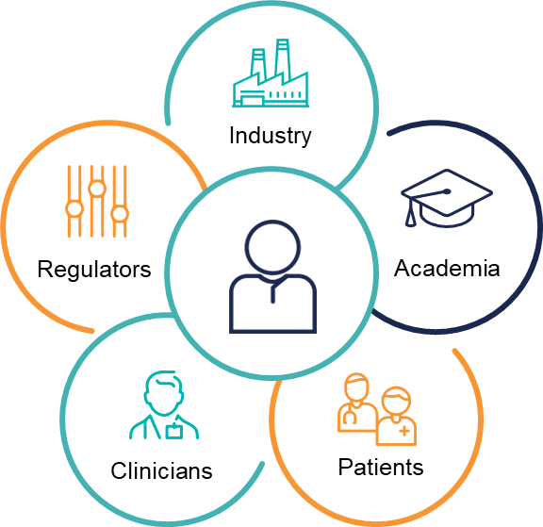
TRUSTroke
Trustworthy by design and privacy-preserving AI-based platform to assist clinicians, patients and caregivers in the management of acute and chronic phases of ischemic stroke
Objectives
Develop a FL network and enable robust and secure distributed AI training
Create integrated trustworthy and validated AI solutions for stroke risk assessment
Create a framework for patient empowerment and communication with integrated prognostic models and stroke outcomes
Validate the performance of the platform in the context of use
Improve stroke patient pathway
EATRIS leads Regulatory Acceptability, Exploitation and Sustainability and contributes to Data Management, Trustworthiness and Bias

Slide 8
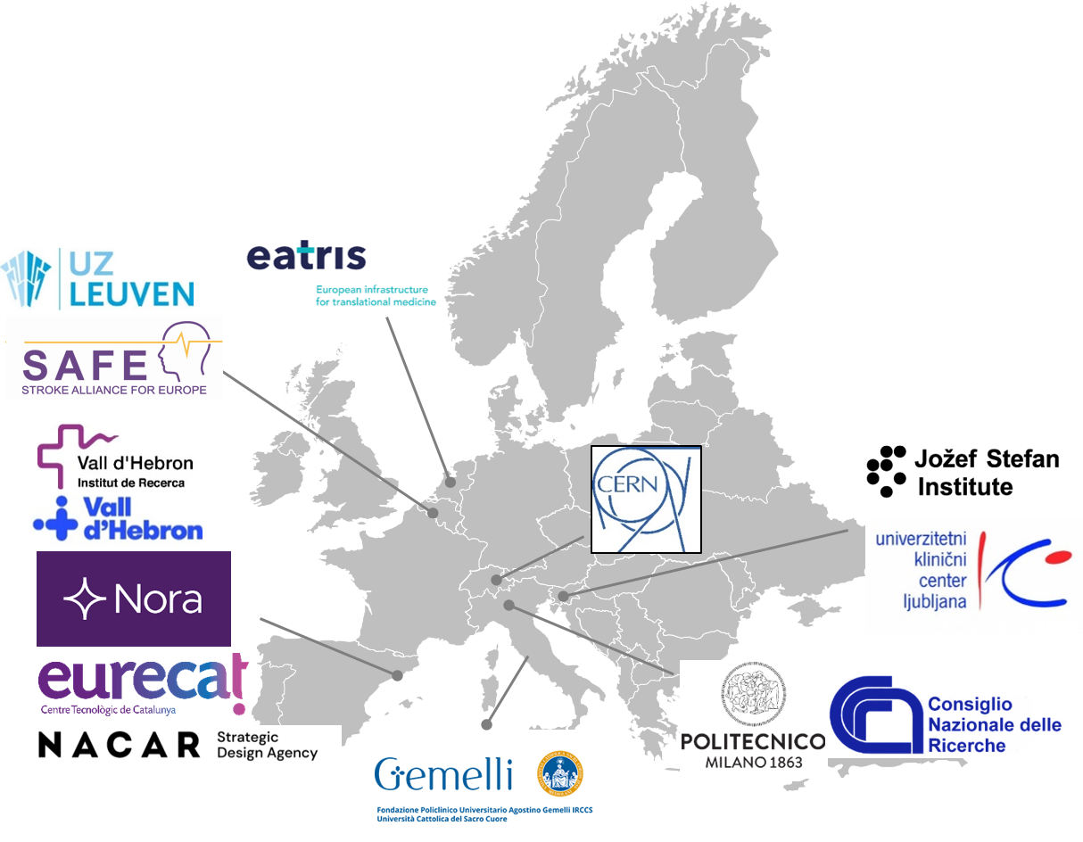
Multi-national collaboration
Consortium:
13 partners
Duration: May 2023 May 2027
www.trustroke.eu
@TRUSTroke_EU
linkedin.com/company/trustroke
Trustroke received funding from the European Union´s Horizon 'Health 2022 STAYHLTH-01-two-stage' program under grant agreement No 101080564.
Notes:
Trustroke is an European Project that is formed by 13 partners arround europe gather academia, industry and healthcare centers. This Project was born in 2023 to achieve several aims….

Slide 9
Cross-sectoral, cross-disciplinary, patient-centric
Trustroke received funding from the European Union´s Horizon 'Health 2022 STAYHLTH-01-two-stage' program under grant agreement No 101080564.

Slide 11
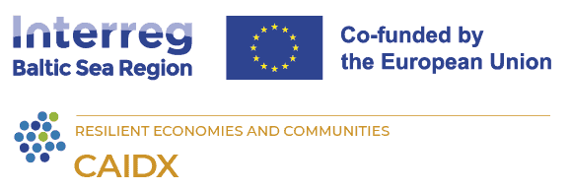
Enabling trustworthy AI-powered solutions in Europe
To develop a robust, trustworthy platform for researchers, clinicians, and innovators to access diverse cancer images, enabling the benchmarking, testing, and piloting of AI-driven technologies
DIGITAL-2022-CLOUD-AI-02-CANCER-IMAGE Project: 10110063
A novel trustworthy by design and privacy-preserving AI-based platform to assist clinicians, patients and caregivers in the management of acute and chronic phases of ischemic stroke.
European Union´s Horizon 'Health 2022 STAYHLTH-01-two-stage: GA No 101080564
To facilitate the uptake of AI and data driven diagnostics tools in clinical day-to-day healthcare delivery
With more projects in the pipeline (IHI, Infra WP, Health)

Slide 12
Conclusions
AI represents another frontier in science & technology
To have impact in society, the science must be coupled with engineering
This can only be done by working across disciplinary and sectoral boundaries
To turn knowledge into useful solutions solving real needs development projects must be driven by users, not the technology developers
Alignment of the all the players is driven by focusing on the patient and their needs
Impact creation is a long knowledge journey
With many actors and gatekeepers along the way

Slide 13
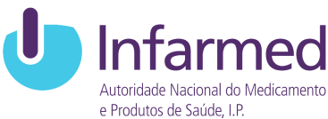
With thanks to our funders and partners
Republic of Bulgaria
Ministry of Education and Science
Republic of Croatia
Ministry of Science and Education
Czech Republic
Ministry of Education,Youth & Sports
Republic of Finland
Ministry of Education and Culture (OKM)
French Republic
Commissariat à l’Energie Atomique et aux Energies Alternatives (CEA)
Italian Republic
Istituto Superiore di Sanità (ISS)
Republic of Latvia
Ministry of Education and Science
Kingdom of Luxembourg
Le Gouvernement du grand-duché de Luxembourg
Kingdom of the Netherlands
ZonMW
Kingdom of Norway
Research Council of Norway*
Kingdom of Norway
University of Oslo*
Republic of Portugal
INFARMED-National Authority of Medicines and Health Products
Republic of Slovenia
Ministry of Education, Science
and Sport
Kingdom of Spain
Instituto de Salud ‘Carlos III’ (ISCIII)
Kingdom of Sweden
Vetenskapsrådet**
Kingdom of Sweden
Vinnova**
*The contribution in Norway is from University of Oslo
**The Swedish contribution is from Vinnova

